Slide 1
Parton femtoscopy with an EIC –
Latest results from simulations
E.C. Aschenauer
for the BNL EIC Science Taskforce

Slide 2
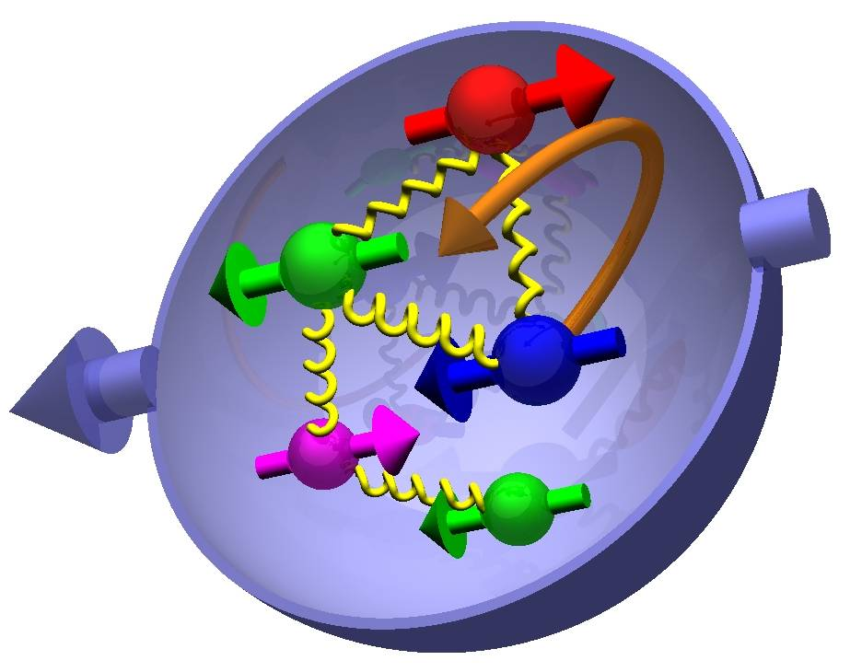
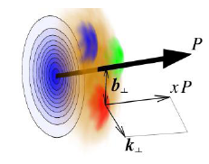

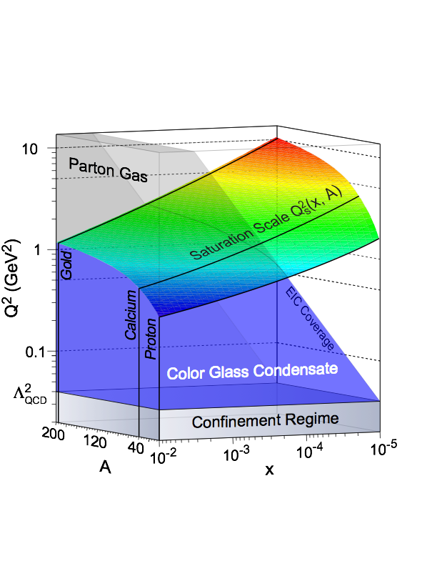
Most Compelling Physics Questions
spin physics
imaging
what is the polarization of gluons at
small x where they are most abundant
what is the spatial distribution of
quarks and gluons in nucleons/nuclei
what is the flavor decomposition of
the polarized sea depending on x
understand deep aspects of gauge
theories revealed by k_{T} dep. distr’n
determine quark and gluon contributions
to the proton spin at last
possible window to
orbital angular momentum
physics of strong color fields
quantitatively probe the universality of
strong color fields in AA, pA, and eA
understand in detail the transition to the non-linear
regime of strong gluon fields and the physics of saturation
how do hard probes in eA interact with the medium

Slide 3
an Electron Ion Collider in the US
Requirements:
High Luminosity > 10³³ cm⁻²s⁻¹
Flexible center of mass energy
Electrons and protons/light nuclei polarised
Wide range of nuclear beams
a wide acceptance detector with good PID
wide acceptance for protons from elastic reactions and
neutrons from nuclear breakup

Slide 4

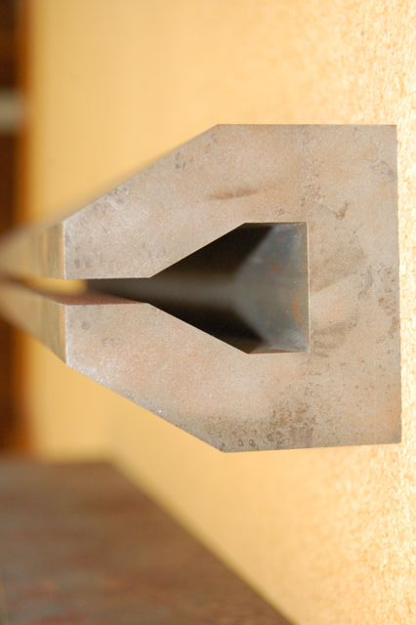

EIC@BNL: eRHIC
All energies scale proportionally by adding SRF cavities to the injector
0.02 Eo
Polarized
e-gun
0.6 GeV
Beam
dump
 | Main Accelerator Challenges In red –increase/reduction beyond the state of the art
 | Polarized electron gun – 10x increase
 | Coherent Electron Cooling – New concept
 | Multi-pass SRF ERL 5x increase in current 30x increase in energy
 | Crab crossing New for hadrons
Polarized ³He production
 |  | Understanding of beam-beam affects New type of collider
 |  | β*=5 cm 5x reduction
 |  | Multi-pass SRF ERL 3-4x in # of passes
 |  | Feedback for kink instability suppression Novel concept
27.55 GeV
New
detector
 | e | p | ²He³ | ⁷⁹Au¹⁹⁷ | ⁹²U²³⁸
Energy, GeV | 20 | 250 | 167 | 100 | 100
CM energy, GeV |  | 141 | 115 | 89 | 89
Number of bunches/distance between bunches | 74 nsec | 166 | 166 | 166 | 166
Bunch intensity (nucleons) ,10¹¹ | 0.24 | 2 | 1.3 | 0.79 | 0.83
Bunch charge, nC | 3.8 | 32 | 10 | 5.2 | 5.2
Beam current, mA | 50 | 420 | 140 | 67 | 67
Normalized emittance of hadrons , 95% , mm mrad |  | 1.2 | 1.2 | 1.2 | 1.2
Normalized emittance of electrons, rms, mm mrad |  | 32 | 48 | 80 | 80
Polarization, % | 80 | 70 | 70 | none | none
rms bunch length, cm | 0.2 | 8.3 | 8.3 | 8.3 | 8.3
β*, cm | 5 | 5 | 5 | 5 | 5
Luminosity per nucleon, x 10³⁴ cm⁻²s⁻¹ |  | 0.97 | 0.65 | 0.39 | 0.41
Linac
Coherent e-cooler
0.9183 Eo
Linac 2.45 GeV
Eo
0.8367 Eo
0.7550 Eo
0.6733 Eo
0.5917 Eo
E/Eo
0.0200
0.1017
0.1833
0.2650
0.3467
0.4283
0.5100
0.5917
0.6733
0.7550
0.8367
0.9183
1.0000
0.5100 Eo
0.4286 Eo
0.3467 Eo
0.2650 Eo
0.1017 Eo
0.1833 Eo
30 GeV
All magnets would installed from day one and we would be cranking power supplies up as energy is increasing
All staging in lepton Beam RF
ePHENIX
eSTAR
100 m
30 GeV
Notes:
We returned to developing cost effective and ECO-friendly eRHIC option with ERL located in the existing RHIC tunnel. We plan to install all magnets for 6 passes and 30 GeV from the start and then build up SRF linac from 1 GeV to 5 GeV per pass.
In this case electrons will pass through the detector halls in the way to the top energy, will collide in up to 3 IRs. Then they will be decelerated to the injection energy and damped.

Slide 5
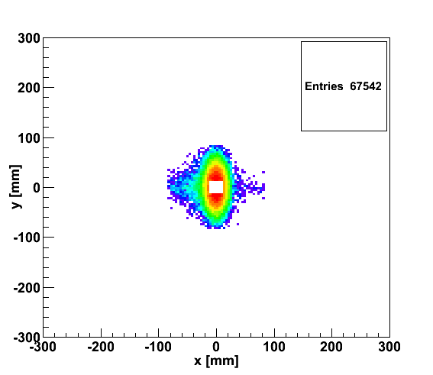
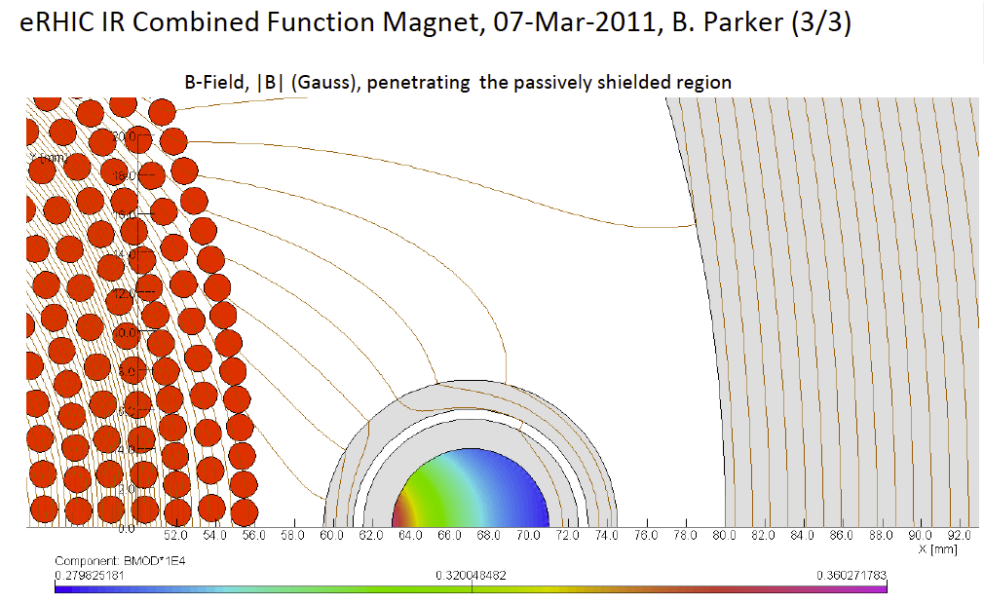
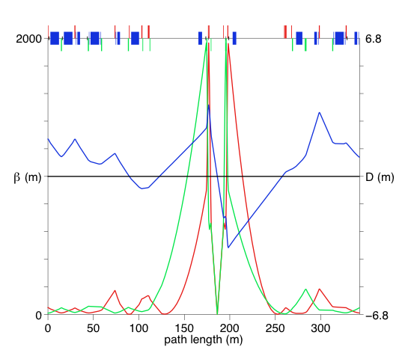
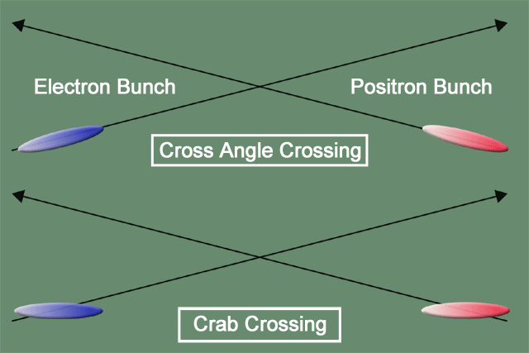
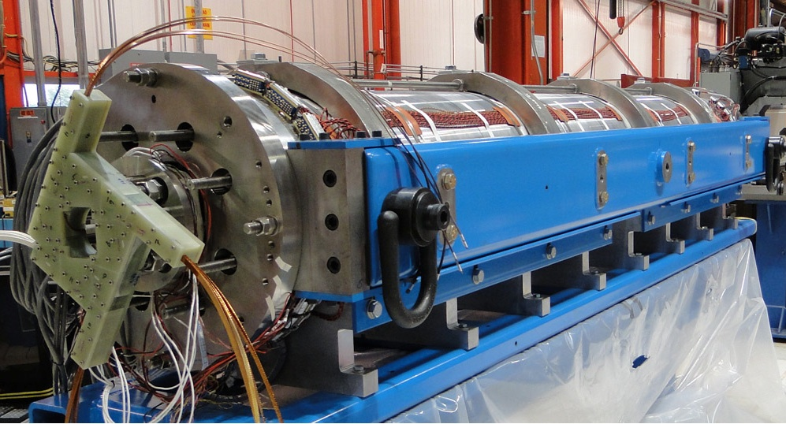
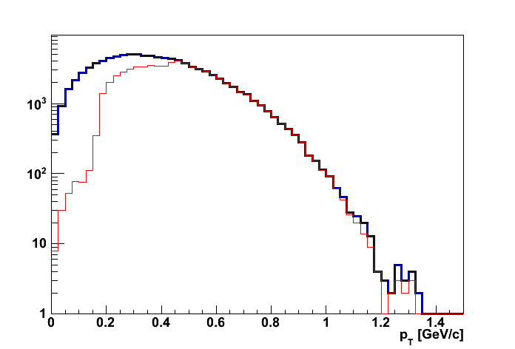
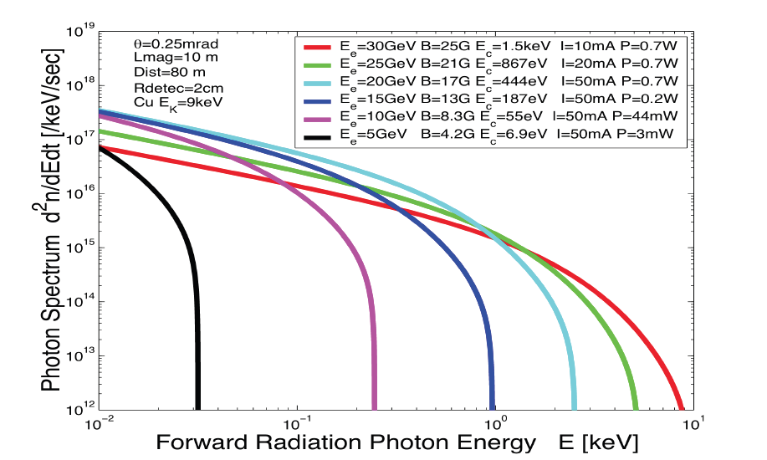
eRHIC high-luminosity IR with β*=5 cm
20x250
p
Proton beam lattice
G.Ambrosio et al., IPAC’10
e
Nb₃Sn
20x250
200 T/m
eRHIC - Geometry high-lumi IR with β*=5 cm, l*=4.5 m
and 10 mrad crossing angle → this is required for 10³⁴ cm⁻² s⁻¹
Generated
Quad aperture limited
RP (at 20m) accepted
10 mrad crossing angle and crab-crossing
High gradient (200 T/m) large aperture Nb₃Sn focusing magnets
Arranged free-field electron pass through the hadron triplet magnets
Integration with the detector: efficient separation and registration of low angle collision products
Gentle bending of the electrons to avoid SR impact in the detector
© D.Trbojevic, B.Parker, S. Tepikian, J. Beebe-Wang

Slide 6
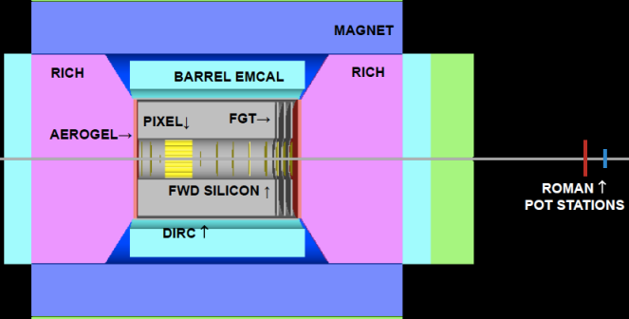
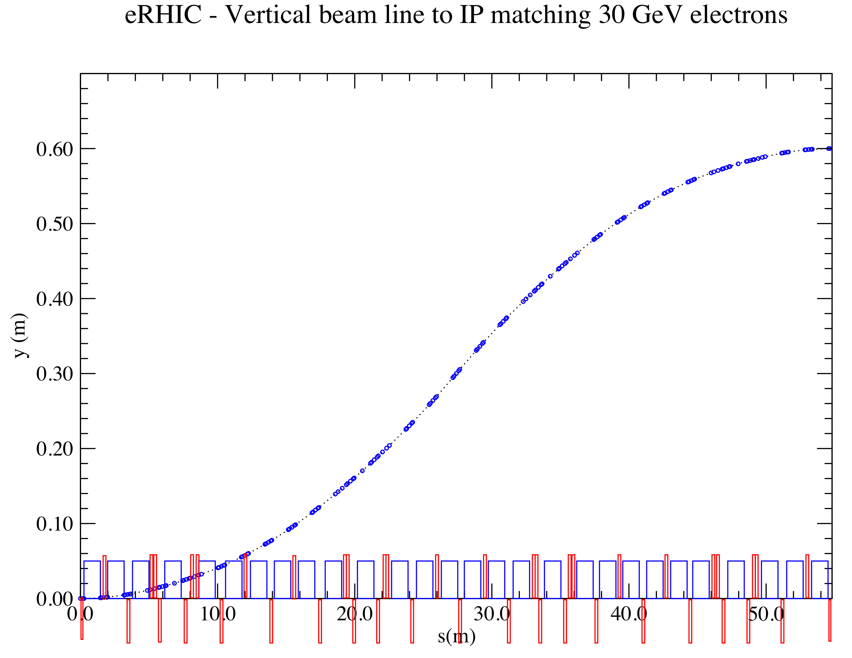
Emerging Detector Concept
K. Dehmelt
Magnet 2-3T
Backward Spectrometer
For very low Q²-electrons:
space for low-Θ
e-tagger
high acceptance -5 < η < 5 central detector
good PID (π,K,p and lepton) and vertex resolution (< 5μm)
tracking and calorimeter coverage the same → good momentum resolution, lepton PID
  Barrel: MAPS & TPC, Forward: MAPS & GEM
low material density → minimal multiple scattering and brems-strahlung
very forward electron and proton/neutron detection → Roman Pots, ZDC, low e-tagger
EIC-Detector R&D-CALL: https://wiki.bnl.gov/conferences/index.php/EIC_R%25D

Slide 7

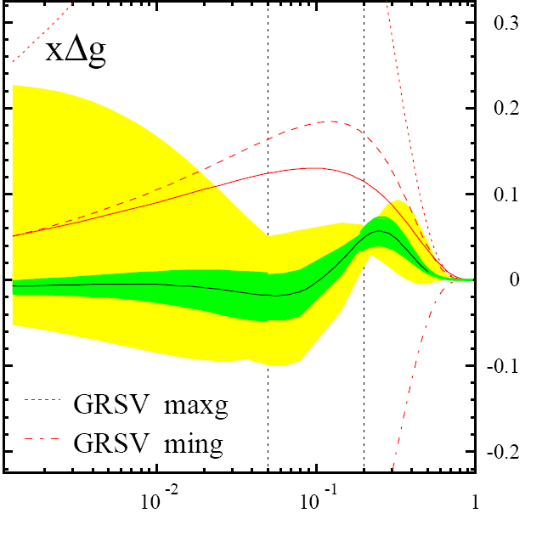
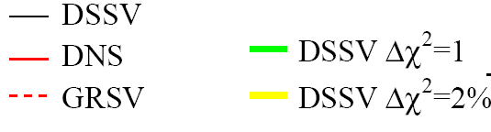
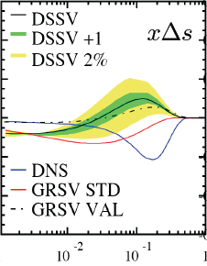

helicity structure - open questions
significant experimental and theoretical progress in past 25+ years, yet many unknows …
Δg(x,Q²)
DSSV global fit
de Florian, Sassot,
MS, Vogelsang
found to be small at 0.05 < x < 0.2 [RHIC, COMPASS, HERMES]
RHIC can slightly extend x range & reduce uncertainties
[500 GeV running & particle correlations]
can hide one
unit of here
yet, full 1st moment [proton spin sum]
will remain to have significant uncertainties
from unmeasured small x region
DIS
&
pp
RHIC
pp
Δq’s (x,Q²)
x
known: quarks contribute much less to proton spin
than expected from quark models
large uncertainties in ΔΣ from unmeasured small x
surprisingly small/positive Δs from SIDIS: large SU(3)
breaking?
_
_
flavor separation not well known, e.g., Δu - Δd

Slide 8
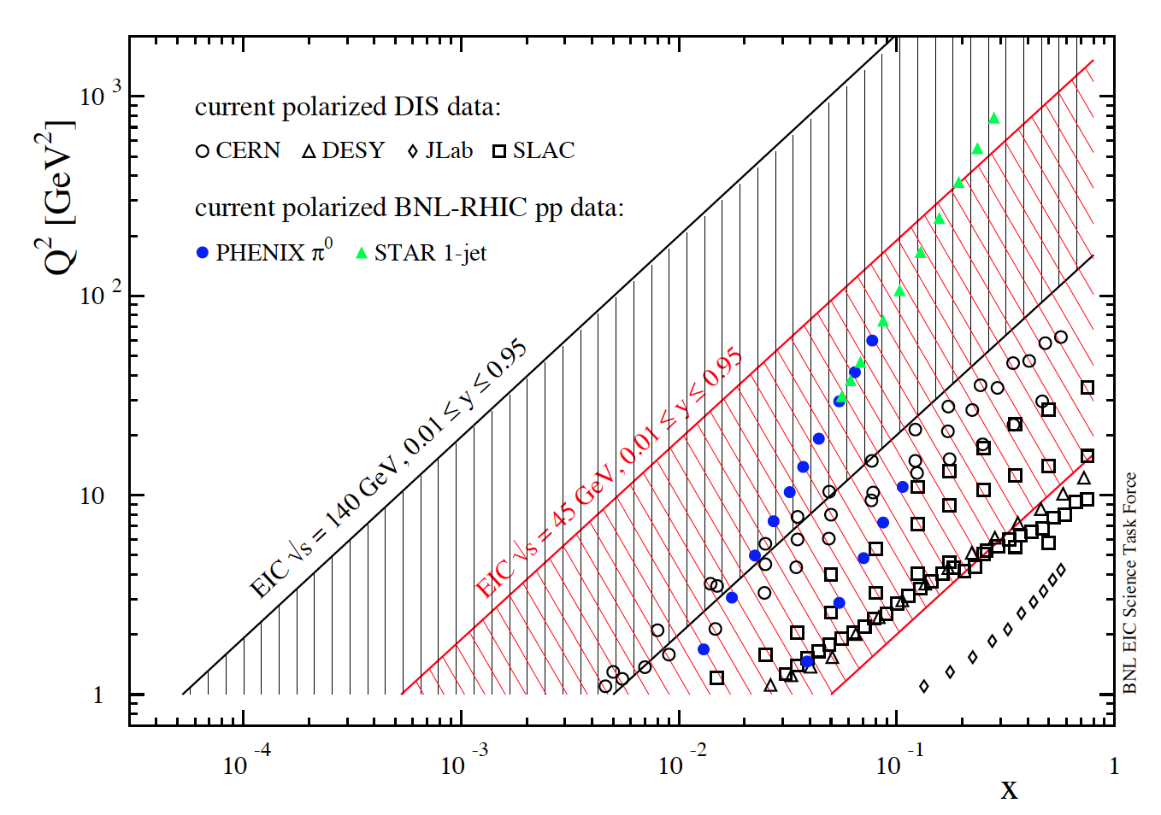
present vs EIC kinematic coverage
EIC might be realized in stages: 5 x 100 – 5 x 250 GeV [eRHIC stageI] to 20(30) x 250 GeV [eRHIC]
RHIC pp data
constraining Δg(x)
in approx. 0.05 < x <0.2
data plotted at x_{T}=2p_{T}/√S
5 x 100 GeV eRHIC stage-1
20 x 250 GeV eRHIC
lowest x so far 4.6 x10⁻³
COMPASS

Slide 9
present vs EIC kinematic coverage
EIC might be realized in stages: 5 x 100 – 5 x 250 GeV [eRHIC stageI] to 20(30) x 250 GeV [eRHIC]
likewise for Q²
EIC extends x coverage
by up to 2 decades
(at Q²=1 GeV²)

Slide 10
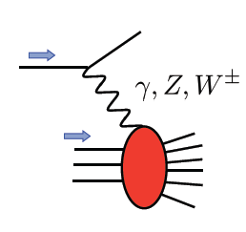
present vs EIC kinematic coverage
EIC might be realized in stages: 5 x 100 – 5 x 250 GeV [eRHIC stageI] to 20(30) x 250 GeV [eRHIC]
novel electroweak probes
(never been measured before)
unprecedented opportunities in DIS, SIDIS, … with polarized beams

Slide 11
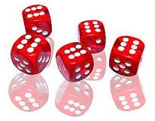
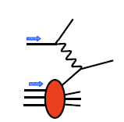
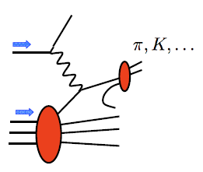
preparation of DIS and SIDIS mock data
PEPSI MC to generate σ⁺⁺ and σ⁺⁻ with LO GRSV PDFs
DIS
SIDIS
inclusive final-state
identified charged pions and kaons
assume modest 10 fb⁻¹ for each energy, 70% beam polarizations
Q² > 1 GeV² , 0.01 < y < 0.95 , invariant mass W² > 10 GeV²
depolarization factor of virtual photon D(y,Q²) > 0.1 (cuts on small y)
scattered lepton: 1º < θ_{elec} < 179º and p_{elec} > 0.5 GeV
hadron: p_{hadr} > 1 GeV, 0.2 < z < 0.9,
1⁰ < θ_{hadr} < 179º
use rel. uncertainties of data to generate mock data by randomizing around
DSSV+ by 1-σ
SIDIS: incl. typical 5% (10%) uncertainty for pion (kaon) frag. fcts (from DSS analysis)

Slide 12
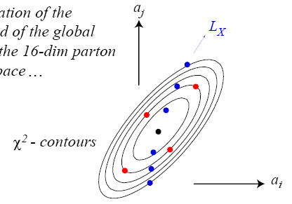
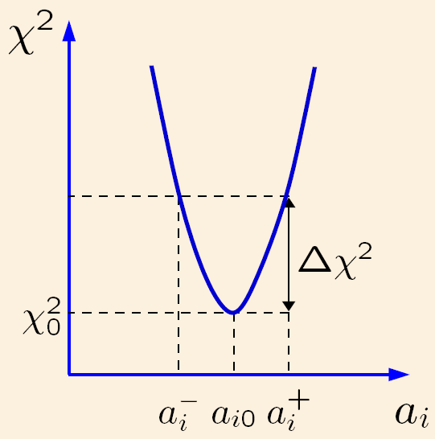
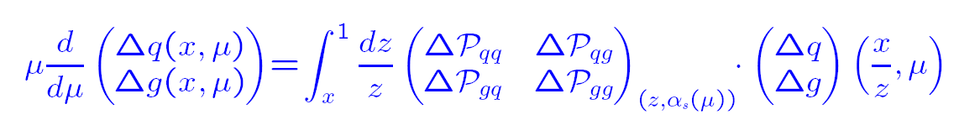
global fits with EIC data & quantifying their impact
follow closely DSSV/DSSV+ framework [same flexible functional form with possible nodes,
Q0, α_{s}] to facilitate comparison of fits with & without EIC mock data
use robust Lagrange multiplier method to
estimate PDF uncertainties
same Δχ²=9 as in DSSV to quantify impact of EIC data
track how fit deteriorates under
certain enforced conditions
explores the full parameter space
standard Hessian method works also well
once EIC data are included (but not with current data)
uncertainty estimates with both methods very similar
explores vicinity of χ² minimum
in quadratic approximation
all fits performed at NLO accuracy
cartoons taken from CTEQ
for discussions later on, recall:
for a PDF at x = x₀ DGLAP evolution only cares about x values larger than x₀
a priori not known down to which value of Q²_{min} DGLAP evolution applies
expect 1-2 GeV² range (HERA) but might be different for helicity PDFs
important to play with Q²_{min} to map out region where DGLAP works [needs an EIC to do that]

Slide 13
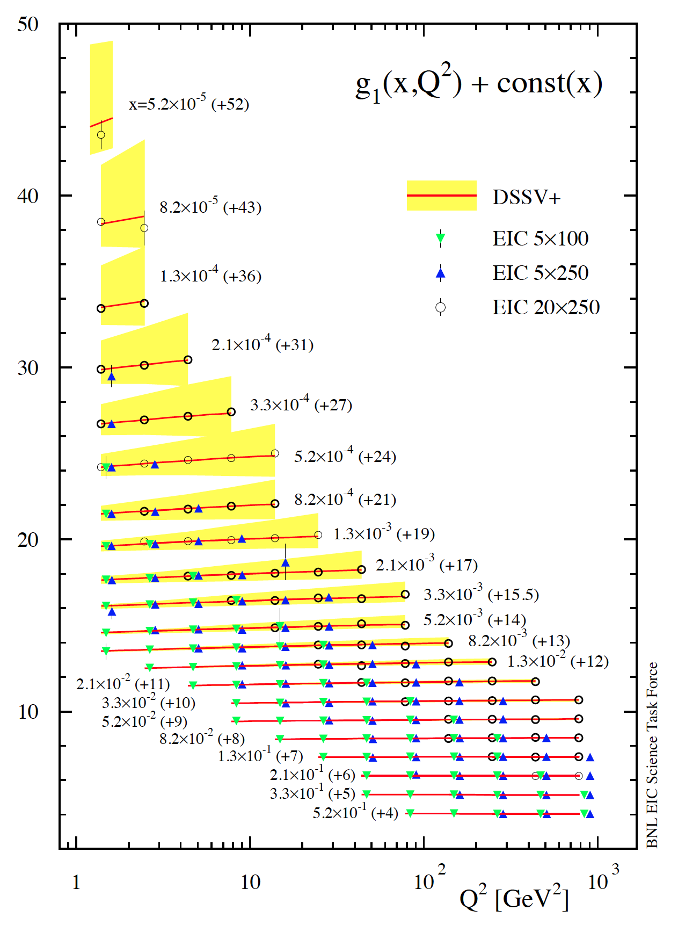
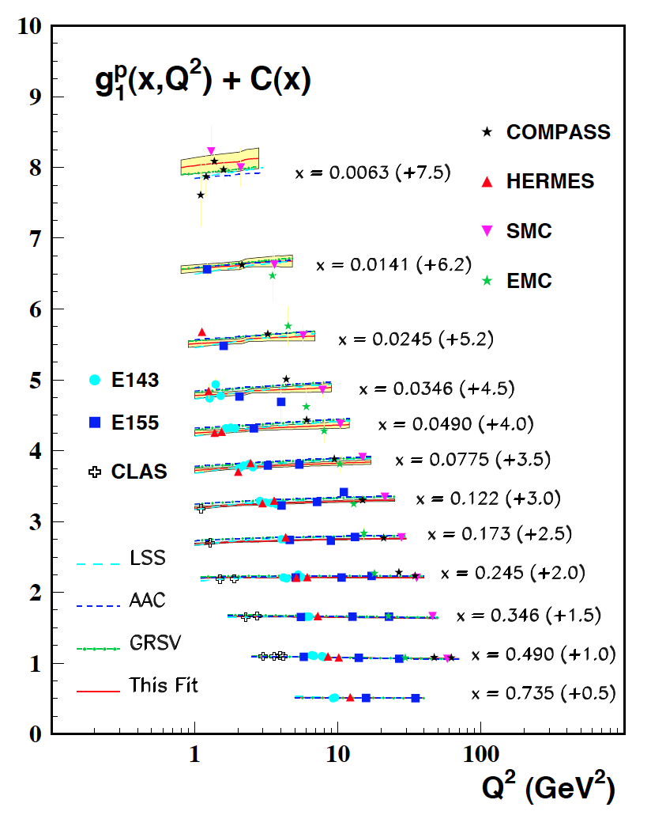
example: projected DIS data for g₁^{p}
3 sets of [eRHIC] energy settings studied:
E_{e}×E_{p} [GeV] | √s [GeV] | x_{min} for y_{max} = 0.95 and Q² = 1 GeV² Q² = 2 GeV²
5 x 100 | 44.7 | 5.3 x 10⁻⁴ 1.1 x 10⁻³
5 x 250 | 70.7 | 2.1 x 10⁻⁴ 4.2 x 10⁻⁴
20 x 250 | 141.4 | 5.3 x 10⁻⁵ 1.1 x 10⁻⁴
5 x 250 starts here
4 [5] bins/decade in Q² [x] (spaced logarithmically)
bands reflect current uncertainties on g₁^{p}
DSSV+ estimate
5 x 100 starts here
COMPASS data
start here
taken from
Blumlein,
Bottcher

Slide 14
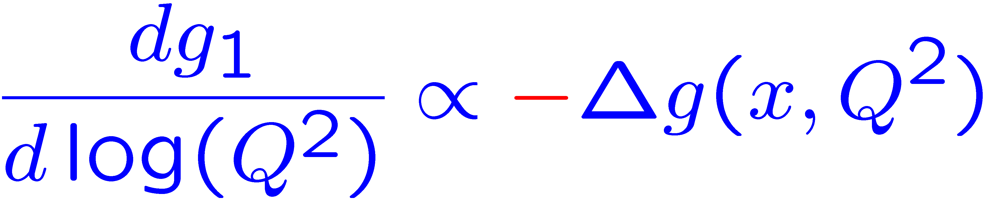
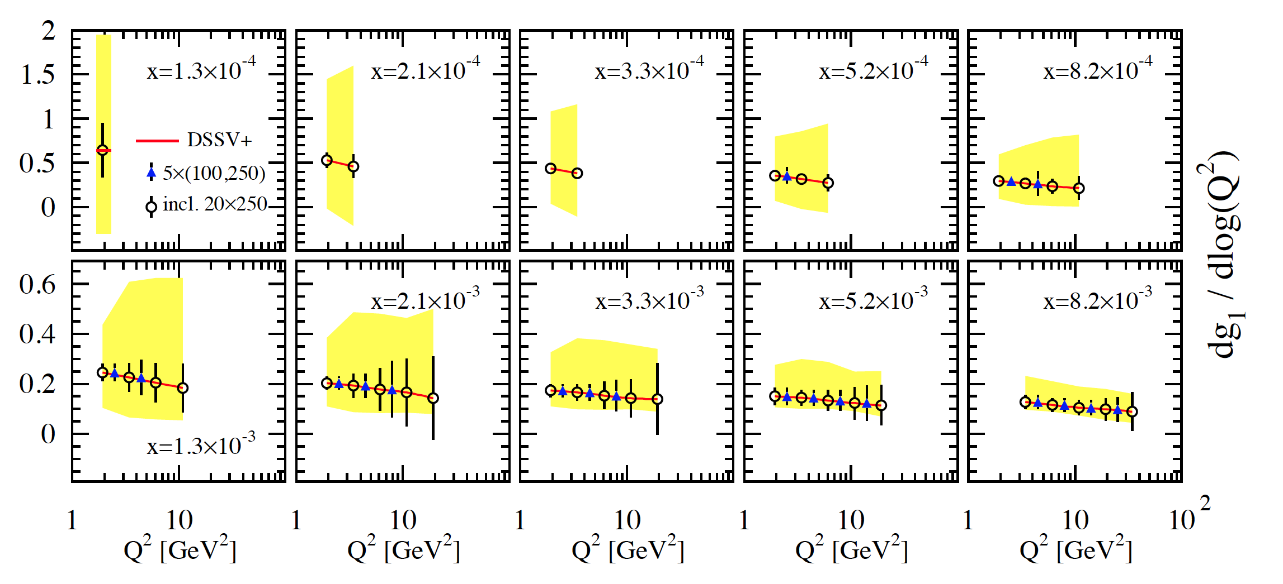
scaling violations at small x
rough small-x approximation to Q²-evolution:
spread in Δg(x,Q²) translates into
spread of scaling violations for g₁(x,Q²)
need x-bins with a least two Q² values to compute derivative (limits x reach somewhat)
smallest x bins require 20 x 250 GeV
5 x 250 starts here
error bars for moderate 10fb⁻¹ per c.m.s. energy; bands parameterize current DSSV+ uncertainties

Slide 15
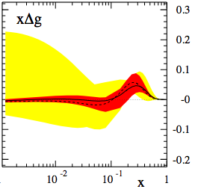

impact of EIC data on helicity PDFs
DIS scaling violations mainly determine Δg at small x
(SIDIS scaling violations add to this)
Q² = 10 GeV²
dramatic reduction of uncertainties:
“before”
“after”

Slide 16
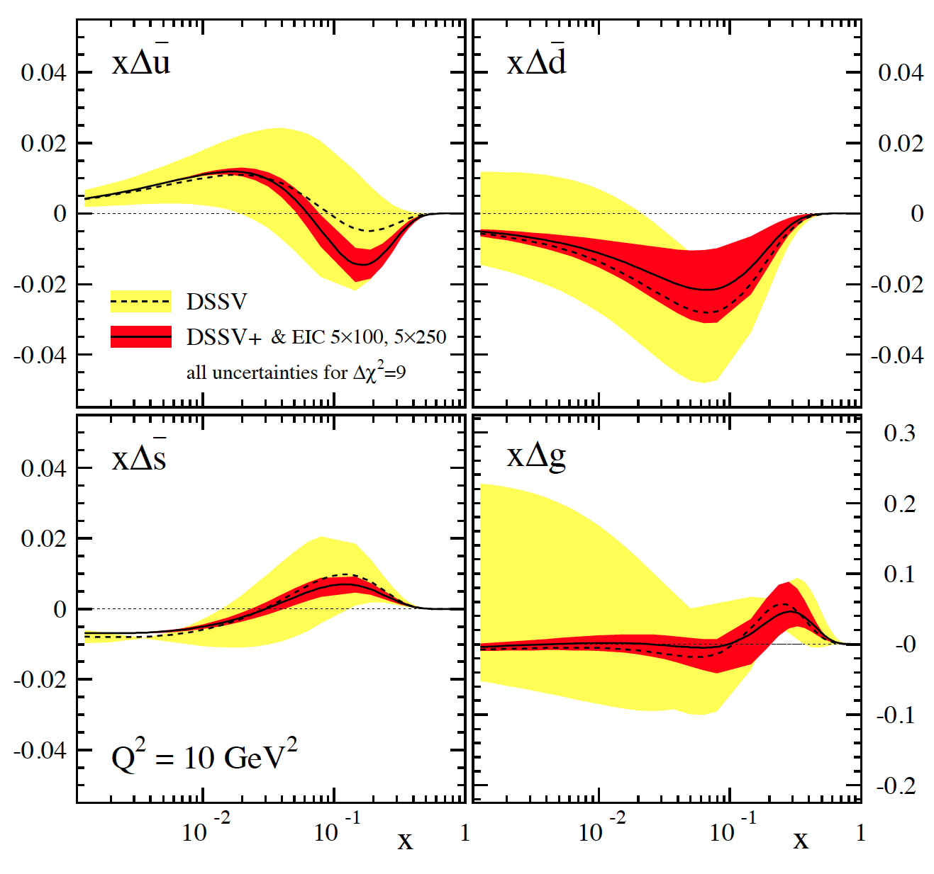
impact of EIC data on helicity PDFs
DIS scaling violations mainly determine Δg at small x
( SIDIS scaling violations add to this)
in addition, SIDIS data provide detailed flavor separation of quark sea
includes only “stage-1 data”
[even then Q²_{min} can be 2-3 GeV²]
can be pushed to x=10⁻⁴ with
20 x 250 GeV data
[still one can play with Q²_{min} ]
uncertainties determined with
both Lagrange mult. & Hessian
“issues”:
(SI)DIS @ EIC limited by
systematic uncertainties
need to control rel. lumi, polarimetry,
detector performance, … very well
QED radiative corrections
need to “unfold” true x,Q²
well known problem (HERA)
BNL-LDRD project to sharpen tools

Slide 17
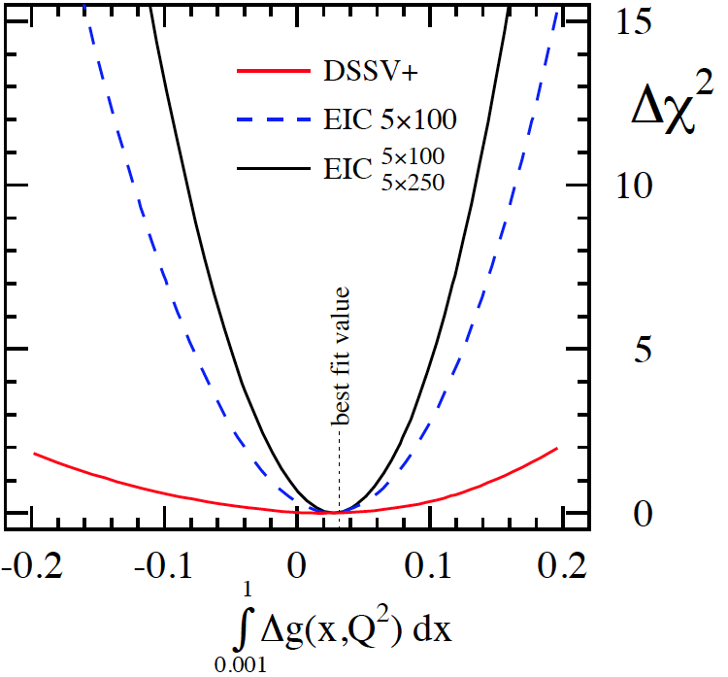
impact of EIC data in terms of χ² profiles
dramatic improvements for [truncated] first moments
best visualized by χ² profiles obtained with Lagrange multipliers
example: Δg in x-range 0.001-1 without/with stage-1 eRHIC data
not well constrained by current data
profile not parabolic
EIC DIS data [eRHIC stage-1]
lead to significant improvement
profile parabolic; Hessian method also works
17

Slide 18
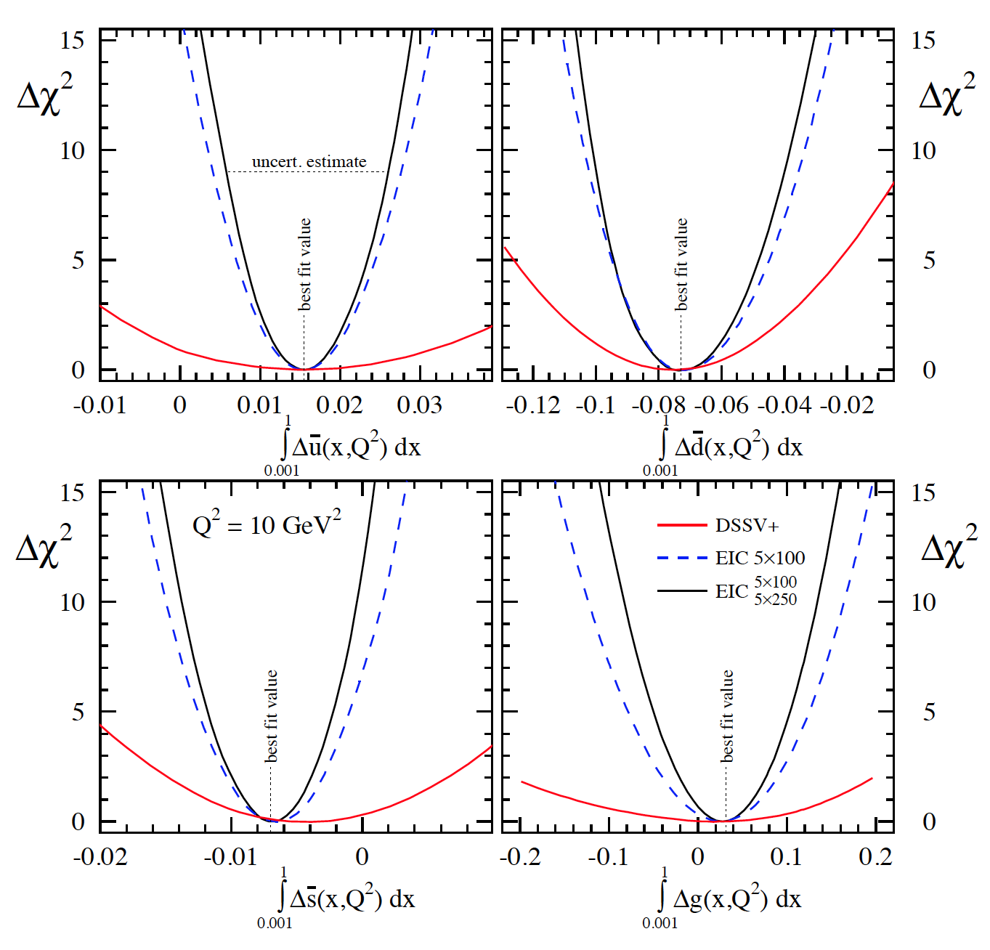
impact of EIC data in terms of χ² profiles
dramatic improvements for [truncated] first moments
best visualized by χ² profiles obtained with Lagrange multipliers
similar improvements for all quark flavors with stage-1 eRHIC SIDIS data
5 x 250 GeV data allow to
study Q²_{min} dependence
of 0.001-1 moments
18

Slide 19
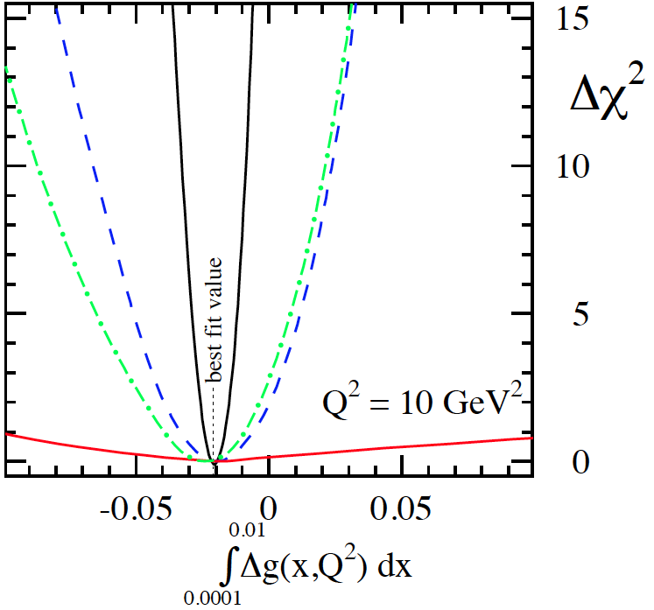
impact of EIC data (cont’d)
further improvements with 20 x 250 GeV data at smaller x
example: Δg in x-range 0.0001-0.01 without/with eRHIC data
20 x 250
data
somewhat less dramatic
for quark sea
impact varies with quark flavor
stage-1
data

Slide 20
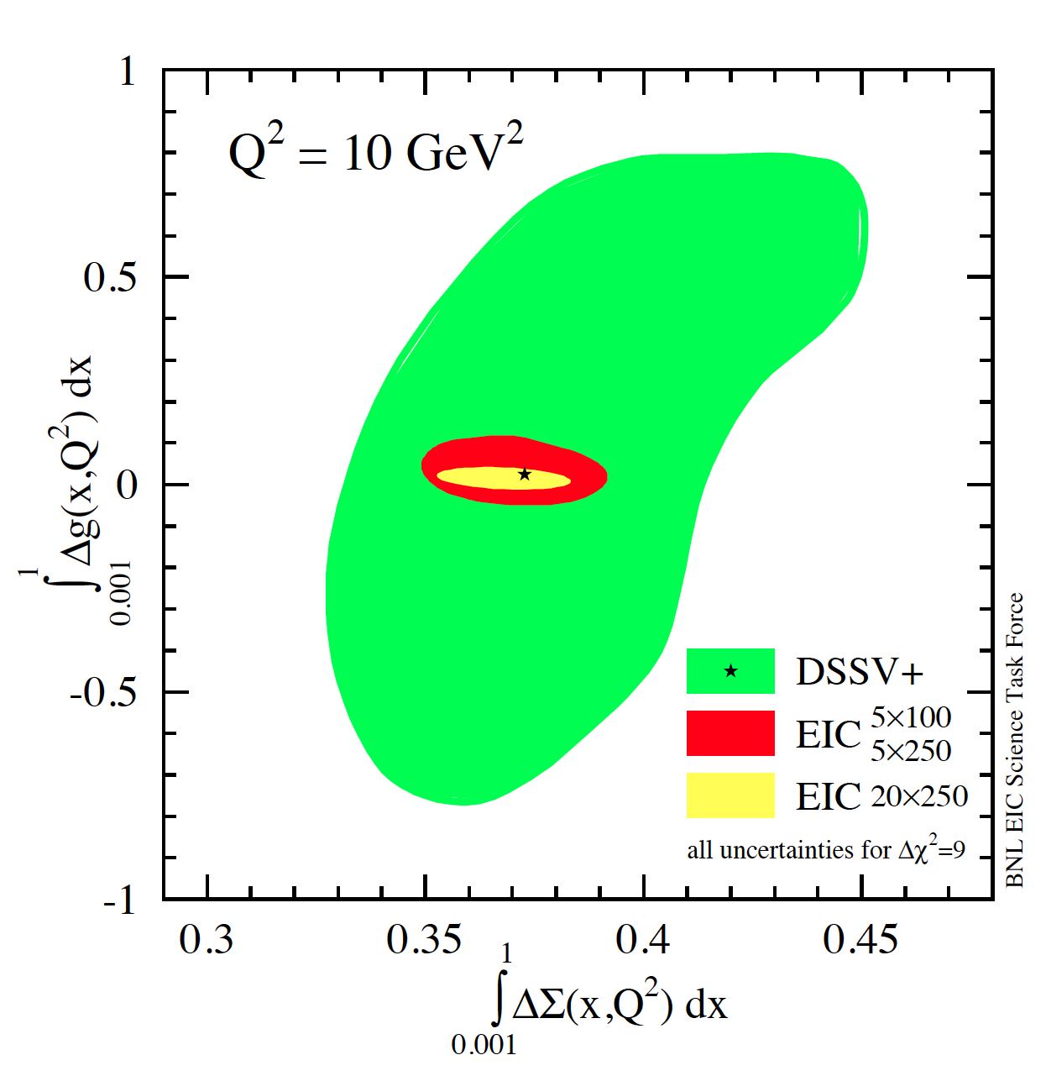
progress towards spin sum rule
combined correlated uncertainties for ΔΣ and Δg
results obtained with two
Lagrange multipliers
Hessian method consistent
current data
similar improvement
for 0.0001-1 moments
needs 20 x 250 GeV data
w/ EIC data
can expect approx. 5-10%
uncertainties on ΔΣ and Δg
but need to control systematics

Slide 21
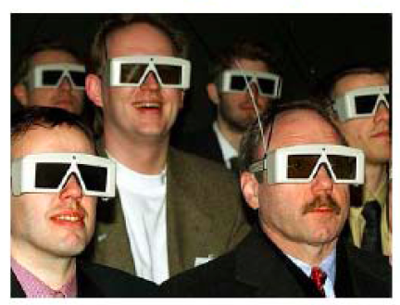
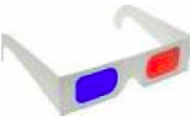
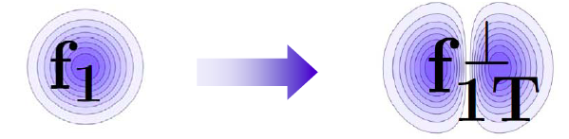
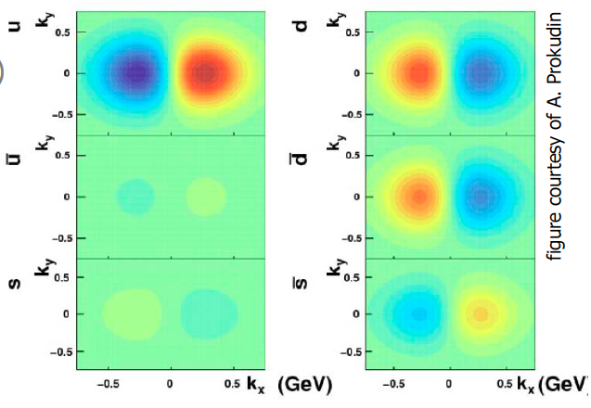
Quantum phase-space tomography of the nucleon
Wigner Distribution
W(x,r,k_{t})
Join the real
3D experience !!
TMDs
GPDs
3D picture in momentum space 3D picture in coordinate space
  transverse momentum generalized parton distributions
  dependent distributions → exclusive reaction like DVCS
Quarks
unpolarised polarised

Slide 22
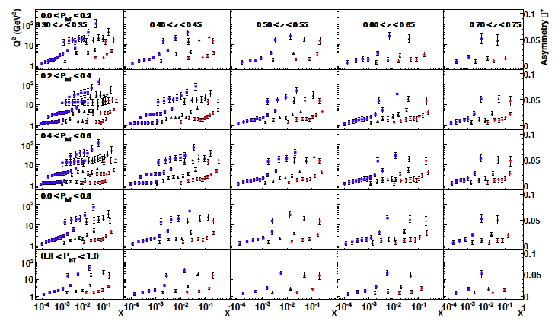
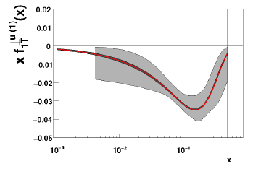
Quark TMDs @ EIC
Sivers asymmetry for π+:
√s=140 GeV / 45 GeV / 15 GeV
u-Sivers fct. before and after
A. Prokudin
What is the influence of evolution
on the size of the asymmetry?
Other quarks look similar
what about the gluon ?

Slide 23
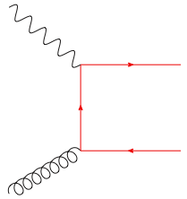
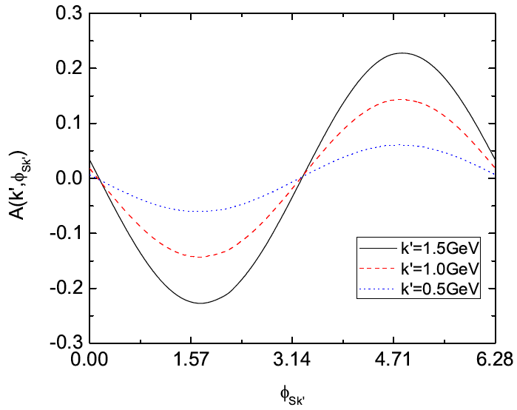
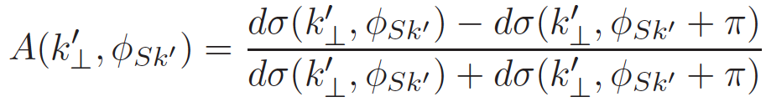
The Gluon Sivers Function: γ*N⇑ → h+h+X
e
k⊥<<p_{t}
qqbar interacts like g
“Correlation limit”
Measure a pair of D mesons
k⊥ = |k1T + k2T|
PT = (k1T - k2T) / 2
study charm to tag PGF
Statistically challenging
N⇑
EIC INT proceedings
arXiv:1108.1713v1
section 2.3

Slide 24
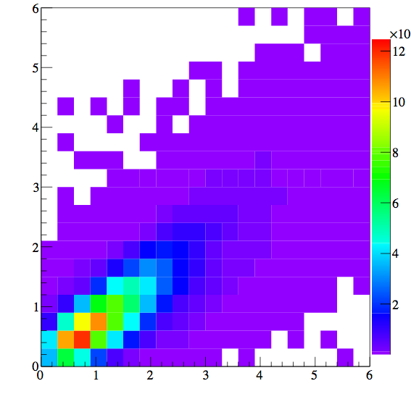
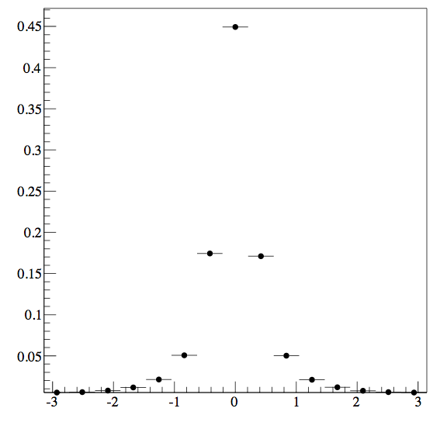
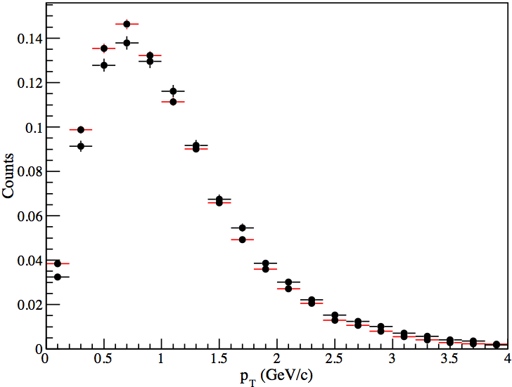
Simulation ASsumptions
Pythia:
unpolarised with CEQT 10 PDF
Beam Energies: 20 GeV x 250 GeV
Q²: 1 – 10 GeV², y: 0.01 – 0.95, z>0.25
no cut on k⊥ and p_{t,} but on k⊥/p_{t} < 0.5 for “correlation limit”
Both D0 and D0-bar → π K
  Easily reconstructed
  Branching ratio 3.87%
  Are down feeds from different Mesons an issue?
  Is the charm Meson a good proxy for the charm quark
kT^{D0} vs kT^{c}
Direct D⁰/D⁰bar
D⁰ from D^{*+}→π⁺D⁰
D⁰bar from D^{*-}→π⁻D⁰
Δϕ(c ↔ D⁰)

Slide 25
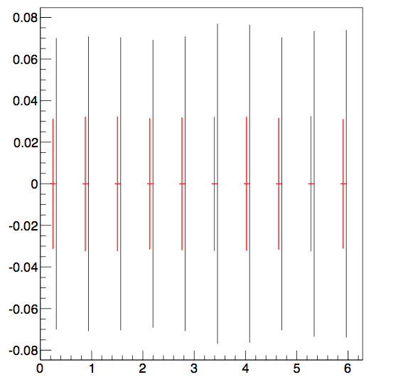

Simulation Result
0.5 < k⊥ < 1
1 < k⊥ < 2
EIC
will allow a measurement of the gluon Sivers function
ϕ
~8 months with 50% efficiency and
L = 10³⁴cm²s⁻¹
1/sqrt(N) error per (ϕ, k⊥) bin, scaled for
    70% beam polarisation
    100 fb⁻¹ integrated luminosity

Slide 26
Quantum phase-space tomography of the nucleon
Wigner Distribution
W(x,r,k_{t})
Join the real
3D experience !!
TMDs
GPDs
3D picture in momentum space 3D picture in coordinate space
  transverse momentum generalized parton distributions
  dependent distributions → exclusive reaction like DVCS
Quarks
unpolarised polarised

Slide 27
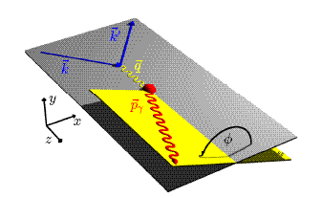
DVCS ASYMMETRIES
→ different charges: e⁺ e⁻:
~
Δσ_{C} ~ cosφ ∙Re{ H + ξH +… }
H
→ polarization observables:
~
Δσ_{LU} ~ sinφ∙Im{H + ξH + kE}
H
Δσ_{UT}
~
~
Δσ_{UL} ~ sinφ∙Im{H + ξH + …}
H
beam target
Δσ_{UT} ~ sinφ∙Im{k(H - E) + … }
H, E
ξ = x_{B}/(2-x_{B} ) k = t/4M²
kinematically suppressed

Slide 28
DVCS Phase Space
Stage 2
Stage 1

Slide 29
MC Simulation
Written by E. Perez, L Schoeffel, L. Favart [arXiv:hep-ph/0411389v1]
The code MILOU is based on GPD convolution by:
Freund and M. McDermott [All ref.s in: http://durpdg.dur.ac.uk/hepdata/dvcs.html]
GPDs, evolved at NLO by an independent code which provides tables of CFF
- at LO, the CFFs are just a convolution of GPDs:
provide the real and imaginary parts of Compton form factors (CFFs), used to calculate cross sections for DVCS and DVCS-BH interference.
-> The B slope is allowed to be constant or to vary with Q²:
Proton dissociation (ep → eγY) can be included
Other non-GPD based models are implemented like FFS, DD

Slide 30
Data Simulation and Selection
Acceptance criteria
    for Roman pots: 0.03< |t| < 0.88 GeV²
    for |t| > 1GeV2 detect recoil proton in
    main detector
    0.01 < y < 0.85 GeV²
    η < 5
BH rejection criteria
(applied to x-sec. measurements)
    y < 0.6
    (θ_{el}-θ_{γ}) > 0
    Eγ >1GeV²; E_{e}>1GeV²
Events smeared for expected resolution in t, Q2, x
Systematic uncertainty assumed to be ~5%
(having in mind experience from HERA)
Overall systematic uncertainty from luminosity
measurement not taken into account
0.01 < |t| < 0.85 GeV²
(Low-|t| sample)
Very high statistics
Systematics will dominate!
Within Roman pots acceptance
1.0 < |t| < 2.0 GeV²
(Large-|t| sample)
Xsec goes down exponentially
requires a year of data taking @ 20x250 GeV (stage 2)
Main detector can be used in measuring |t|
eRHIC-Stage 1: 5 X 100 GeV → ~10 fb⁻¹ (~ a year)
eRHIC-Stage 2: 20 X 250 GeV → ~100 fb⁻¹ (~ a year)

Slide 31
GPDs: DVCS@eRHIC
b=5.6
Specifications:
Statistical error down to 1%
It uses smeared t values (5% momentum resol.)
|t|-binning –> 3 * resolution (or higher)
5 X 100
(~ 10 months EIC)
S. Fazio

Slide 32
BH Fraction
5 GeV x 100 GeV
BH subtraction will be relevant in stage 1, at large y, depending on the x-Q² bin
BUT…
5 GeV x 100 GeV
and
5 GeV x 250 GeV
are overlapping:
x-sec. measurements at 5x250 at low-y can
crosscheck the BH
subtrac. made for 5x100
20 GeV x 250 GeV
BH subtraction will be not an issue for y<0.6

Slide 33
DVCS Asymmetries
Plots from D. Mueller

Slide 34
What will we learn about 2d+1 structure of the proton
GPD H and E as function of t, x and Q²
GPD H and E 1d+1
Plots from D. Mueller
GPD H and E 2d structure for quarks
A global fit over all mock data was done, based on the GPDs-based model:
[K. Kumerički, D Müller, K. Passek-Kumerički 2007]
Known values q(x), g(x) are assumed for H^{q}, H^{g} (at =0, t=0 forward limits E^{q}, E^{g} are unknown)
Excellent reconstruction of H^{sea}, H^{sea} and good reconstruction of H^{g} (from dσ/dt)

Slide 35
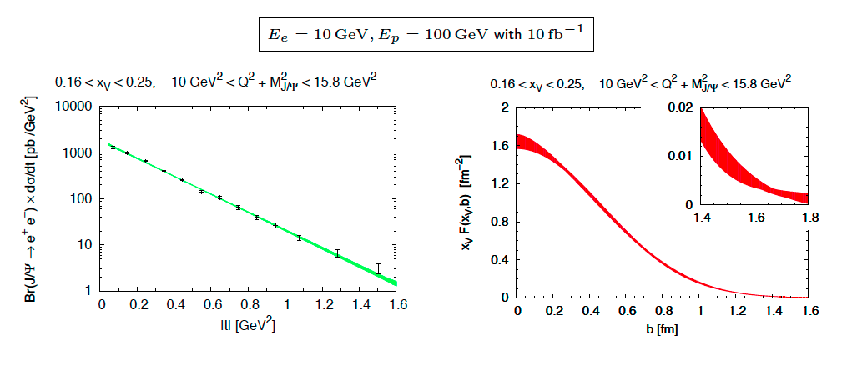
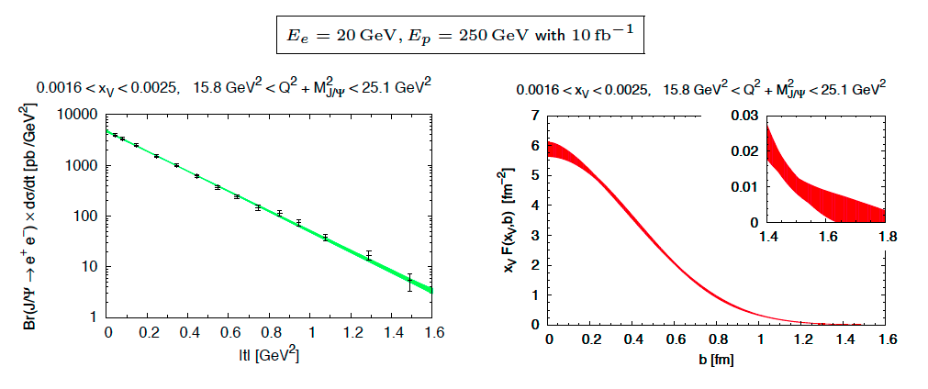
GPD H^{g}: J/ψ
To improve imaging on gluons
add J/ψ observables
cross section
A_{UT}
…..
need still to do combined fit
in Dieter’s model
Plots: M. Diehl

Slide 36

How many gluons have space in A proton?
BK/JIMWLK non-linear evolution includes
recombination effects → saturation
  Dynamically generated scale
  Saturation Scale: Q²_{s}(x)
    Increases with energy or decreasing x
  Scale with Q²/Q²_{s}(x) instead of x and Q²
small x / higher energy
x = P_{parton}/P_{nucleon}
Terra Incognita
Bremsstrahlung
~ α_{s}ln(1/x)
Recombination
~ α_{s}ρ
Saturation must set in at
low x → high occupancy
α_{s}~1 α_{s} << 1

Slide 37


Reaching the Saturation Region
HERA (ep):
Despite high energy range:
F2, Gp(x, Q²) outside the
saturation regime
Need also Q² lever arm!
Only way in ep is to
increase √s
Would require an ep
collider at √s ~ 1-2 TeV
L ~ (2m_{N} x)⁻¹ > 2 R_{A} ~ A^{1/3}
Probe interacts coherently with all nucleons
Different approach (eA):

Slide 38
Best Knowledge of QS in eA
Model-I: IPSat dipole model
Model-II: BK + higher order corr.
Enhancement of Q_{S} with A
⇒ saturation regime reached at significantly lower energy in nuclei

Slide 39
EIC eA Key Measurements
Key Measurements: Small set of measurements whose
ability to extract novel physics is beyond question.
Low x:
EIC INT-Report: arXiv:1108.1713v1
Large x:

Slide 40
What Do We Know About xG in Nuclei?
99% of all h± have p_{t} < 2 GeV/c
“Bulk Matter” → x < 0.01
Other than in p:
G(x,Q²) for nuclei is little known
Key: F_{L} (x,Q²) ~ xG(x,Q²)

Slide 41

Measuring FL with the EIC (I)
quark+anti-quark
momentum distributions
gluon momentum distribution
In practice use reduced cross-section:
How to extract F_{L}
  Need different values of y²/Y⁺
  FL slope of σr vs y²/Y⁺
  F2 intercept of σr vs y²/Y⁺ with y-axis
  σr
  y²/Y⁺
0
Notes:
\begin{eqnarray*}\sigma_r = \left( \frac{d^2 \sigma}{dx dQ^2}\right)\ \frac{x Q^4}{2 \pi \alpha^2 [1 + (1-y)^2]}
&=& F_2(x, Q^2) - \frac{y^2}{\color{red}{1+(1-y)^2}} F_L(x, Q^2) \\
{} &=& F_2(x, Q^2) - \frac{y^2}{{\color{red}Y^+}} \ F_L(x, Q^2) \\\end{eqnarray*}

Slide 42



Measuring FL with the EIC (II)
In order to extract F_{L} one needs at least two measurements of the inclusive cross section with “wide” span in inelasticity parameter y (Q² = sxy)
F_{L} requires runs at various √s ⇒ longer program
Need sufficient lever arm in y²/Y⁺
Limits on y²/Y⁺:
At small y:
detector resolution for e’
At large y:
radiative corrections and charge symmetric background
EIC studies:
Statistical error is negligible
in essentially whole range
Systematical Error
Calibration
Normalization
Experiment
Radiative Corrections
Notes:
Lowest value of x and Q2 :
y y2/Y+ proton p
0.7 0.44 100
0.54 0.24 130
0.28 0.28 250

Slide 43

h-h Forward Correlation in p(d)A at RHIC
side-view
beam-view
large-x1 (q dominated)
p
p
A
π
low-x2 (g dominated)
Low gluon density (pp):
pQCD predicts 2→2 process ⇒ back-to-back di-jet
High gluon density (pA):
2 → many process
⇒ expect broadening of away-side
  Small-x evolution ↔ multiple emissions
  Multiple emissions → broadening
  Back-to-back jets (here leading hadrons) may get broadening in pT with a spread of the order of QS
First prediction by: C. Marquet (’07)
Latest review: Stasto, Xiao, Yuan arXiv:1109.1817 (Sep. ’11)
Notes:
Raju: Di-hadron correlations are a test of universality because the same measurement in p+A and e+A is sensitive to "dipole" and "quadrupole" operators which are the same for both processes.

Slide 44

π⁰−π⁰ Forward Correlation in dA at RHIC
arXiv:1008.3989v1
  Striking broadening in central dAu of away-side compared to pp and peripheral dAu
  Difficult to reproduce in pQCD with linear evolution
  x range: x ~ 10⁻³

Slide 45

Dihadron Correlations in eA at EIC
EIC:
  Extract the spatial multi-gluon correlations and study their non-linear evolution
    essential for understanding the transition from a deconfined into a confined state.
Advantage over p(d)A:
  eA experimentally much cleaner
    no “spectator” background to subtract
    Access to the exact kinematics of the DIS process (x, Q²)
Perfect saturation signature:
Either jets or use leading hadrons from jets (dihadrons)
Notes:
Raju: Di-hadron correlations are a test of universality because the same measurement in p+A and e+A is sensitive to "dipole" and "quadrupole" operators which are the same for both processes.

Slide 46

EIC: eA Dihadron Correlations Studies
Dominguez, Xiao, Yuan, Lee, Zheng ‘11/12
Exp: Saturation versus
“conventional” scenario
Theory: Saturation
eA-MC: Pythia6.4 + nPDF (EPS09) + nuclear geometry from DPMJetIII
without PS
Here for 10 fb⁻¹/A (~ 20 weeks), std. experimental cuts
Clear signal, pronounced differences between sat and no-sat

Slide 47





Hard Diffraction in DIS at Small x
e+p
t = (p-p’)²
β is the momentum fraction of the struck parton w.r.t. the Pomeron
xIP = x/β: momentum fraction of the exchanged object (Pomeron) w.r.t. the hadron
Diffraction Analogy: plane monochromatic wave incident on a circular screen of radius R
  Diffraction in e+p:
    coherent ⇔ p intact
    incoherent ⇔ breakup of p
    HERA: 15% of all events are hard diffractive
Diffraction in e+A:
  coherent diffraction (nuclei intact)
  breakup into nucleons (nucleons intact)
  incoherent diffraction
  Predictions: σdiff/σtot in e+A ~25-40%

Slide 48


Why is DiFfraction So Important
Sensitive to spatial gluon distribution
  Hot topic:
    Lumpiness?
    Just Wood-Saxon+nucleon g(b)
  Incoherent case: measure fluctuations/lumpiness
  in g_{A}(b)
Sensitive to gluon momentum distributions
  σ ~ g(x,Q²)²

Slide 49

Why Is Diffraction So Difficult?
Key in identifying diffraction is
rapidity gap
  requires hermetic detector
  does not allow separation of
coherent from incoherent
Measuring the scattered nucleus with
Forward Spectrometer (Roman Pots)
  coherent → cannot separate
  from beam
  incoherent → cannot reconstruct
all fragments to get p’
LRG
Cannot measure t in eA except in exclusive vector meson production, e.g.:
Lack of t not a big issue for measurements of F2^{D}, FL^{D} and hence G(x,Q²)
e + A → e’ + J/ψ + A’

Slide 50


Large Rapidity Gap Method (LRG)
  Identify Most Forward Going
  Particle (MFP)
    Works at HERA but at higher √s
    EIC smaller beam rapidities
Diffractive ρ⁰ production at EIC:
η of MFP
M. Lamont ’10
DIS
Hermeticity requirement:
needs just to detector presence
does not need momentum or PID
simulations: √s not a show stopper for EIC
(can achieve 1% contamination, 80% efficiency)
Diffractive

Slide 51




Exclusive Vector Meson Production
  Golden channel: e + A → e’ + A’ + VM
    Only channel where t can be derived from VM and e’
    Detecting neutron emission from nuclear breakup allows to separate coherent from incoherent
Dipole Cross-Section:
J/ψ
ϕ

Slide 52
Diffraction Sensitive to Saturation
Simple but effective
Measurement:
  σ_{Diff(eA)}/_{σDiff(ep)}/A^{4/3} as fct. of Q²
  Coherent events only scale with A^{4/3} for large Q²
  Sartre event generator based on dipole model
    describes HERA data
  nosat: dipole cross-section linearized
Clear difference in model prediction between sat and nosat
nosat
sat
J/ψ
nosat
φ
sat

Slide 53



and Summary
without EIC
we will just be able to
explored the
tip of the iceberg
to understand gluons
and sea quarks
you are here
EIC
will be a quantum step to
provide the answers to many
of our questions
why WE have mass
protons spin
“understand” non linear effects
initial conditions for AA
………….
Physics Case: http://arXiv.org/pdf/1108.1713
Δu_{tot}, Δd_{tot}
Knowledge about
Gluons in p /A
GPDs
TMDs
Δs
Δg
L_{q,g}
spin sum rule

Slide 54
BACKUP

Slide 55



Kinematics of Breakup Neutrons
Results from GEMINI++ for 50 GeV Au
Results:
With an aperture of ±3 mrad we are in relative good shape
• enough “detection” power for t > 0.025 GeV²
• below t ~ 0.02 GeV² we have to look into photon detection
‣ Is it needed?
Question:
For some physics rejection power for incoherent is needed ~10⁴
→ How efficient can the ZDCs be made?
by Thomas Ullrich
+/-5mrad acceptance seems sufficient

Slide 56


Diffractive Physics: p’ kinematics
Diffraction:
t=(p4-p2)² = 2[(mp^{in}.mp^{out})-(E^{in}E^{out} - pz^{in}pz^{out})]
→ “ Roman Pots” acceptance studies see later
?
5x50
p’
5x100
5x250
Simulations by J.H Lee

Slide 57




proton distribution in y vs x at s=20 m
without quadrupole aperture limit
20x250
5x50
with quadrupole aperture limit
20x250
5x50

Slide 58


Accepted in“Roman Pot”(example) at s=20m
25x250
5x50
25x250
5x50
Generated
Quad aperture limited
RP (at 20m) accepted

Slide 59


Detectors at eRHIC
M. Lamont
eSTAR :
proton/nucleus
electron
The goal: to provide smooth transition sPHENIX → ePHENIX
  Make sure sPHENIX upgrades consistent with ePHENIX physics
  Immediate focus: central barrel, as the proposal for sPHENIX barrel to be submitted in July 2012
  Working on forward/backward spectrometer design to satisfy both pp+HI and DIS physics
  IR design influence and bunch spacing for DAQ/triggering to be considered
TOF
ECal
TPC i.s.
GCT
GEM
disks
pp/pA forward upgrade
GCT: compact tracker with enhanced electron capability
  combine high-threshold (gas) Cherenkov with TPC-like tracking
TPC: replace inner sectors
  make a greater density of pad rows
TOF: π, K Id,
ECal: electrons, photons
A. Bazilevski

Slide 60


probing a possible asymmetry in the polarized sea
current SIDIS data not sensitive to (known to be sizable for unpol. PDFs)
many models predict sizable asymmetry [large N_{C} , chiral quark soliton, meson cloud, Pauli blocking]
Thomas, Signal, Cao; Holtmann, Speth, Fassler;
Diakonov, Polyakov, Weiss; Schafer, Fries; Kumano;
Wakamatsu; Gluck, Reya; Bourrely, Soffer, …
can be easily studied at an EIC
with stage-1 data
main effect expected to be at not too small x
can try to look into a possible
with K^{+/-} SIDIS data
needs improved frag. fcts. first

Slide 61
More insights to the proton
Transversity distribution function δq(x)
Correlation between and
Single Spin Asymmetries
Unpolarized distribution φυνχτιον q(x), G(x)
beyond collinear picture
Explore spin orbit correlations
Helicity distribution function Δq(x), ΔG(x)
Boer-Mulders distribution function
Correlation between and
peculiarities of f⊥_{1T}
chiral even naïve T-odd DF
related to parton orbital angular momentum
violates naïve universality of PDFs
QCD-prediction: f⊥_{1T,DY} = -f⊥_{1T,DIS}
Sivers distribution function
Correlation between and

Slide 62



GPDs Introduction
How are GPDs characterized?
unpolarized polarized
conserve nucleon helicity
flip nucleon helicity
not accessible in DIS
quantum numbers of final state select different GPD
DVCS
pseudo-scaler mesons
vector mesons
π⁰ | 2Δu+Δd
η | 2Δu−Δd
ρ⁰ | 2u+d, 9g/4
ω | 2u−d, 3g/4
φ | s, g
ρ⁺ | u−d
J/ψ | g
x+ξ, x-ξ long. mom. fract.
t = (p-p’)²
ξ ≅ x_{B}/(2-x_{B})

Slide 63

Processes to study Single Spin Asymmetries
π,K,γ
jet
γ*
π,K
u,d,s,g
u,d,s
u,d,s,g
polarized SIDIS
δq_{f}, f⊥_{1T}
polarized pp scattering
? δq_{f}, f⊥_{1T}?
e⁺/μ⁺
e⁻/μ⁻
polarized DY
f⊥_{1T}
γ∗
u
u,d,s
polarized W-prod.
f⊥_{1T}
d

Slide 64

GPD Modeling and evolution
outer region governs the evolution at the cross-over trajectory
GPD at η = x is `measurable’ (LO)
net contribution of
outer + central region is
governed by a sum rule:

Slide 65




Glue Governs HI at RHIC & LHC
99% of all h± have p_{T} < 2 GeV/c
“Bulk Matter” ⇒ x < 0.01
Jets (π⁰) Production

Slide 66

eA vs. pA Dihadron Correlations Studies
J: relative yield pairs in eAu (pAu) collisions compared to
ep (pp) collisions scaled by A^{1/3} (N^{coll})
Data: Phenix ’11
  p(d)A: x cannot be measured, xfrac is approximation
  Test of universality: p+A and e+A are sensitive to "dipole" and "quadrupole" operators which (same for both processes)

Slide 67




Imbalance in di-hadron correlations
x~10⁻³-10⁻⁴
<xg>~ 10⁻²
Xiao, 2012
At small-x collective gluon distributions are important
Suppression of away-side peak and increase of width (de-
correlation at ΔΦ=π) at large Q² in eA due to multiple interactions
between partons and dense nuclear matter in the CGC frame work
Factor of 2 suppression predicted in eAu with saturation relative
to ep (Xiao, Yuan (2012))

Slide 68

dihadron correlation at EIC
theory
EIC expected data expected from 1fb⁻¹ integrated luminosity (30x100)
  estimated using Pythia+nPDF+DPMJETIII (without saturation)
  Q²=4 GeV² (at Q²=1 ~x10 statistics)
  hadron pT cut: trigger / assoociate = 2 / 1 GeV/c
Differential measurement: crossing onset of saturation using √s, Q², A

